Slide 1

THE FUTURE OF HRIS
Notes:
1

Slide 2
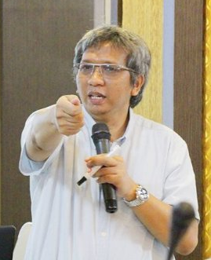
Heru Wiryanto
Specialization : Data Science, Psychometric, Social Network Analysis
Education : Degree - Psychology UNPAD
Graduate - I/O Psychology UI
Post Grad - Cambridge Univ UK, Waseda Univ.
Current Position : HR and Organizational Data Scientist, Psychometrics, HR
Consultant
Certification : Psychometric Testing, Objective Measurement, Data
Mining, Predictive Validity, People Analytics.
Github : https://github.com/Abuamany
Mobile Phone : 081384453331 (WA/Telegram/Line)
email : heruwiryanto@gmail.com or heruwiryanto@icloud.com
Notes:
Perkenalan diri.
1

Slide 3
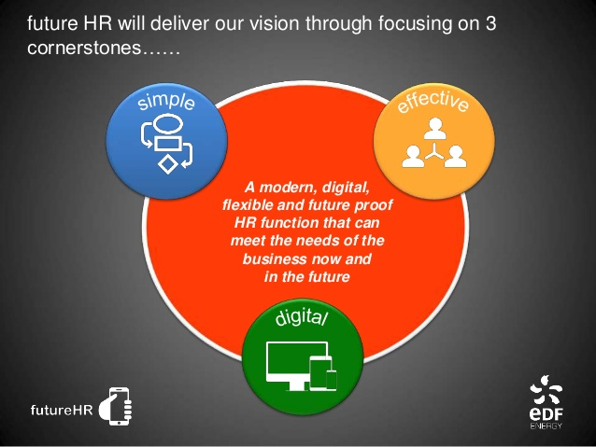

Slide 4
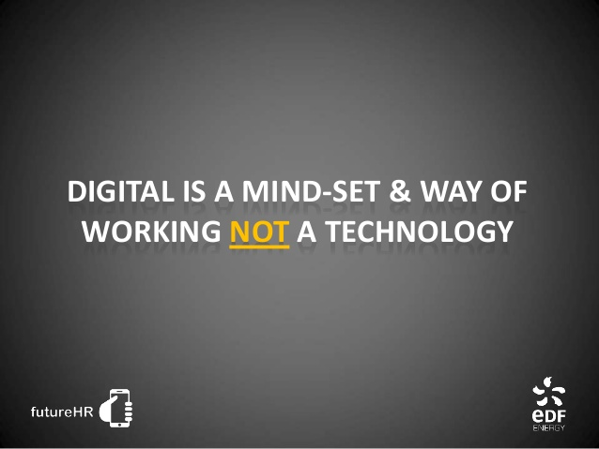

Slide 5
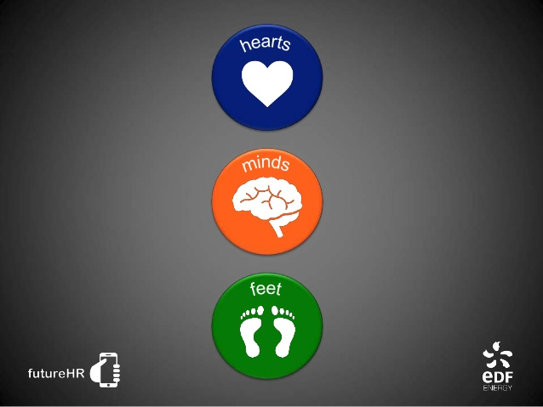

Slide 6
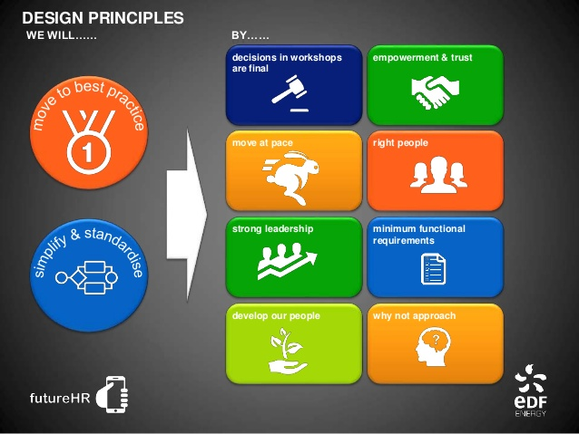

Slide 7
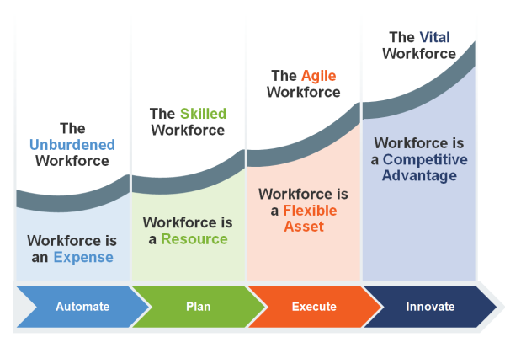

Slide 8
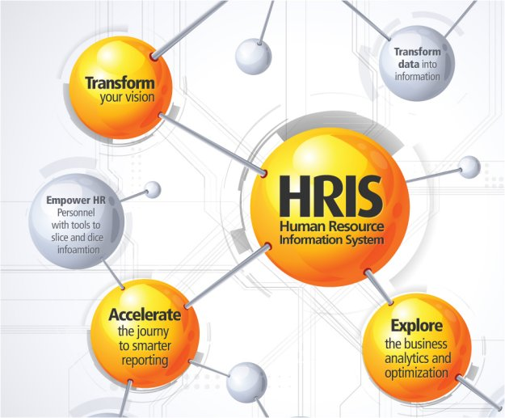

Slide 9
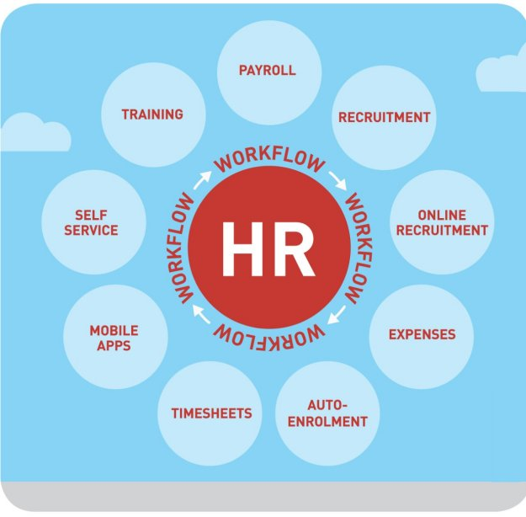

Slide 10
HR Analytics Maturity Model
Source: Berson & Associates, 2012
Stage 4: Predictive Analytics
Development of predictive models, scenario planning,
risk analysis and mitigation, integration with strategic planning.
Stage 3: Strategic Analytics
Segmentation, statistical analysis, development of “people models”, analysis
of dimensions to understand cause and delivery of actionable solutions.
Stage 2: Proactive – Advanced Reporting
Operational reporting for benchmarking and
decision making, multi-dimensional analysis and dashboards.
Stage 1: Reactive – Operational Reporting
Operational reporting for measurement of efficiency and compliance,
data exploration and integration, development of data dictionary

Slide 11
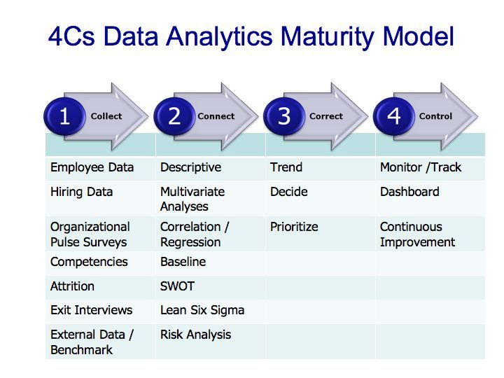

Slide 12
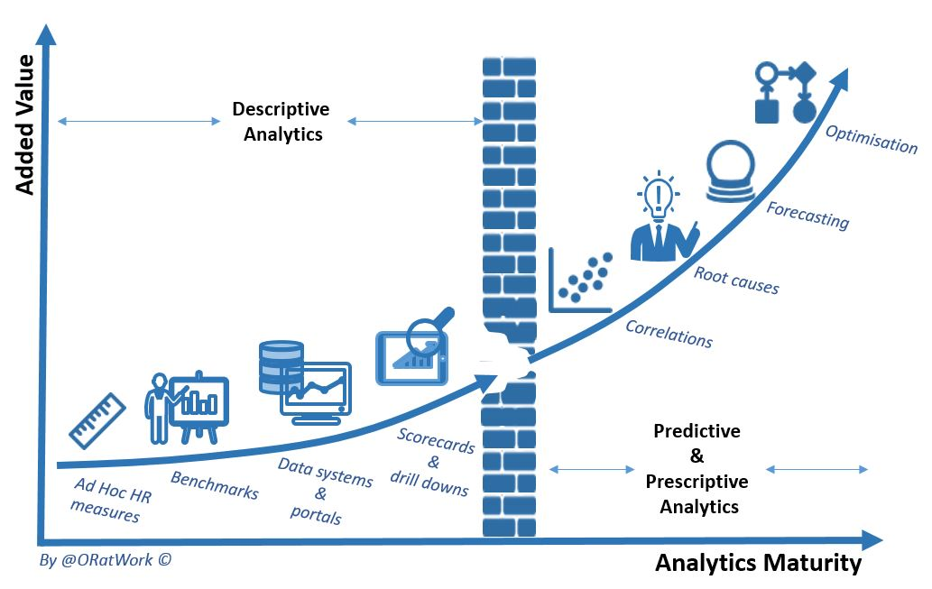

Slide 13
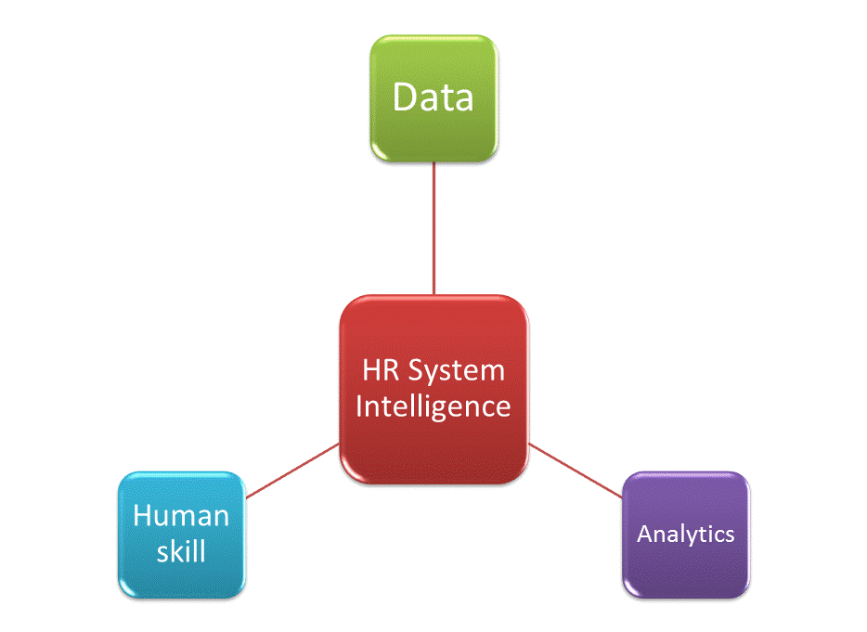

Slide 14
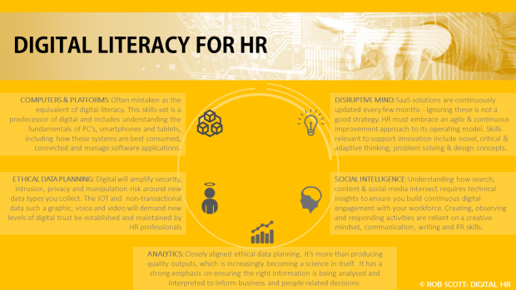

Slide 15


Slide 16
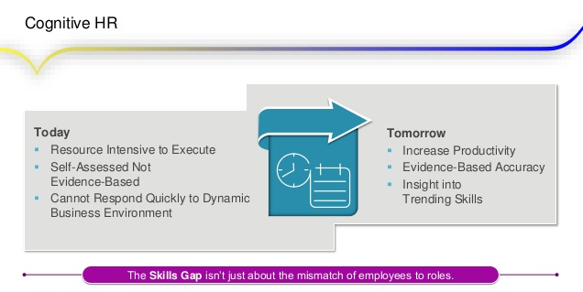

Slide 17
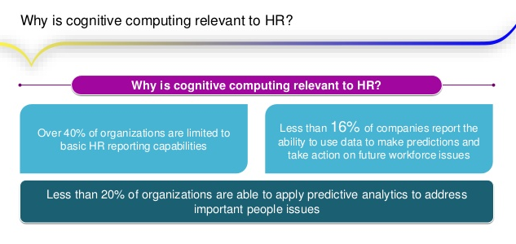

Slide 18
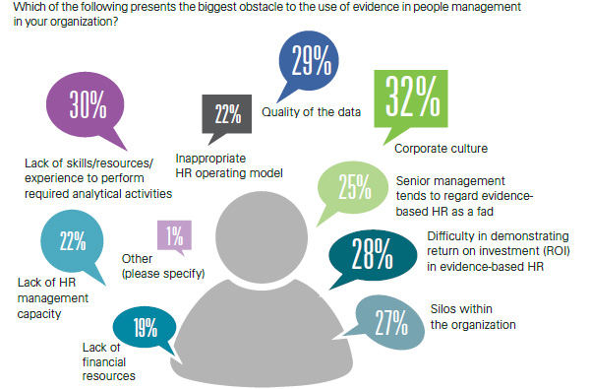

Slide 19
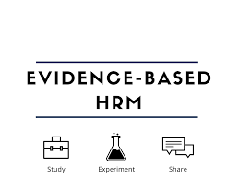
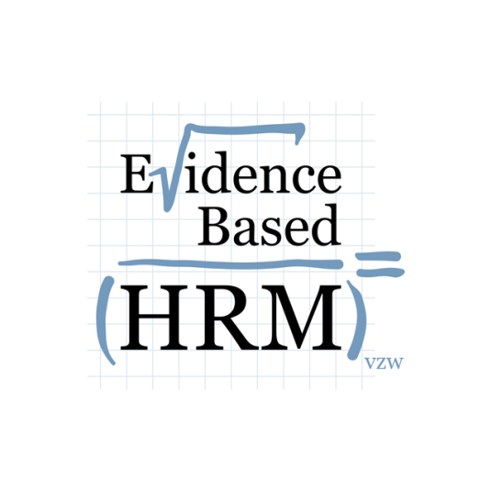
The Case for Evidence - Based HR

Slide 20
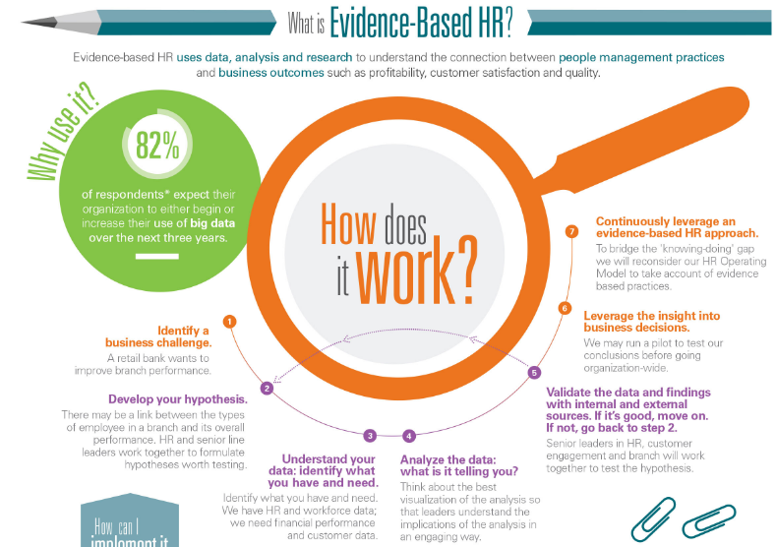

Slide 21
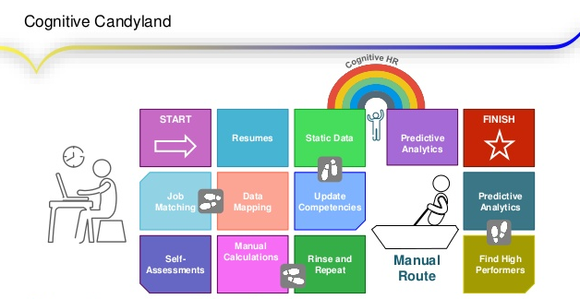

Slide 22
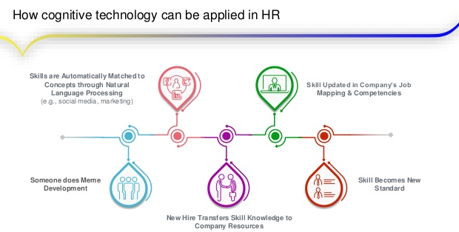

Slide 23
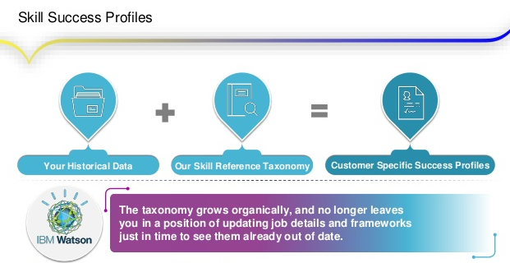

Slide 24
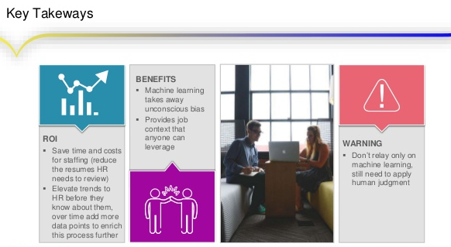

Slide 25
